Slide 1
The Sluggard – a lullaby

Slide 2
Sluggard – the problem Prov 26v12-16
¹² Do you see a person wise in their own eyes? There is more hope for a fool than for them. ¹³ A sluggard says, ‘There’s a lion in the road, a fierce lion roaming the streets!’ ¹⁴ As a door turns on its hinges, so a sluggard turns on his bed. ¹⁵ A sluggard buries his hand in the dish; he is too lazy to bring it back to his mouth. ¹⁶ A sluggard is wiser in his own eyes than seven people who answer discreetly.

Slide 3
Davey’s shop - a boy’s memory

Slide 4
The sluggard’s life What does it look like/How did it happen?
Proverbs 24v30-34
³⁰ I went past the field of a sluggard, past the vineyard of someone who has no sense; ³¹ thorns had come up everywhere, the ground was covered with weeds, and the stone wall was in ruins. ³² I applied my heart to what I observed and learned a lesson from what I saw: ³³ a little sleep, a little slumber, a little folding of the hands to rest – ³⁴ and poverty will come on you like a thief and scarcity like an armed man.

Slide 5
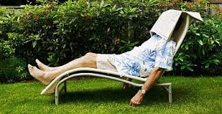
Prov 24v33 A little sleep, a little slumber

Slide 6
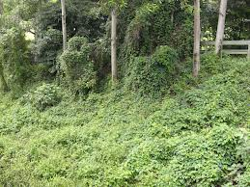
Pr 24 v31 - Little by little……. ……The ground was covered in weeds

Slide 7
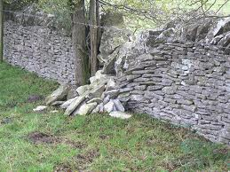
Little by little
Pr 24 v31 - Little by little……
………The stone wall was in ruins

Slide 8
The remedy Proverbs 6v6-11
⁶Go to the ant, you sluggard; consider its ways and be wise! ⁷ It has no commander, no overseer or ruler, ⁸ yet it stores its provisions in summer and gathers its food at harvest.
⁹ How long will you lie there, you sluggard? When will you get up from your sleep? ¹⁰ A little sleep, a little slumber, a little folding of the hands to rest – ¹¹ and poverty will come on you like a thief and scarcity like an armed man.

Slide 9
The bible’s beautiful balance Prov 10v3-5
3The Lord does not let the righteous go hungry,
but he thwarts the craving of the wicked.
4 Lazy hands make for poverty,
but diligent hands bring wealth.
5 He who gathers crops in summer is a prudent son,
but he who sleeps during harvest is a disgraceful son.

Slide 10
Our current position Titus 2v13-14
“while we wait for the blessed hope – the appearing of the glory of our great God and Saviour, Jesus Christ, who gave himself for us to redeem us from all wickedness and to purify for himself a people that are his very own, eager to do what is good.”

